Slide 1
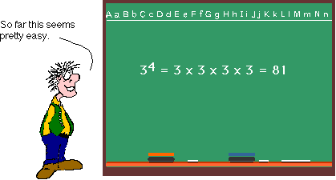
The Laws of Exponents

Slide 2
What are the exponents?
The exponents, also called powers, define how many times we have to multiply the base number.

Slide 3
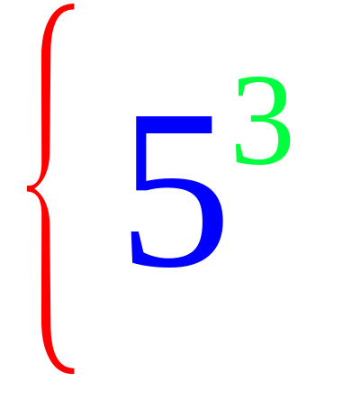
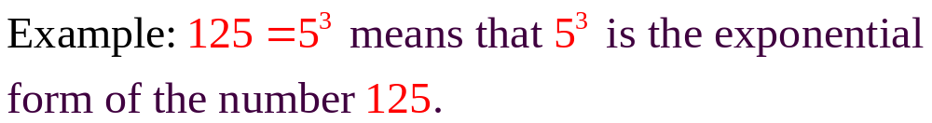
Exponents
exponent
Power
base
5³ means 3 factors of 5 or 5 x 5 x 5

Slide 4


Slide 5
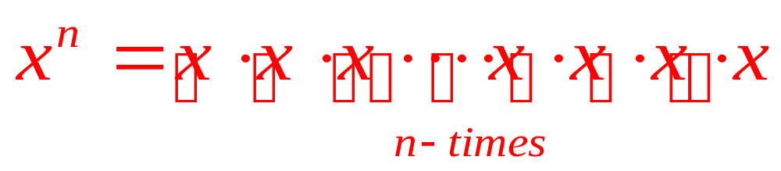
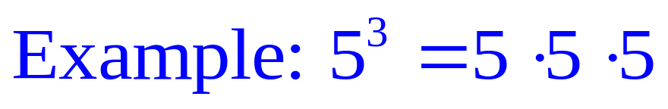
The Laws of Exponents:
#1: Exponential form: The exponent of a power indicates
how many times the base multiplies itself.
n factors of x

Slide 6
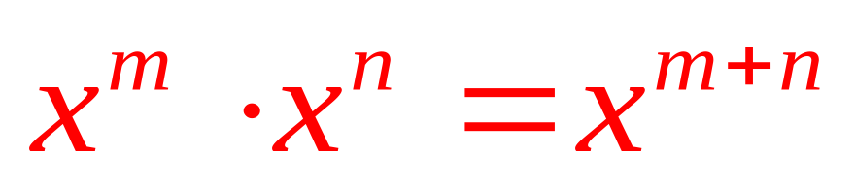
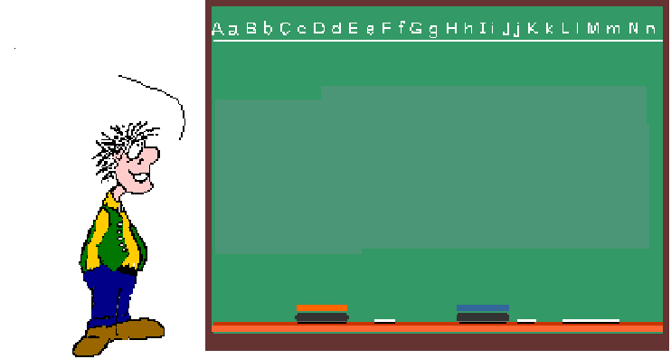
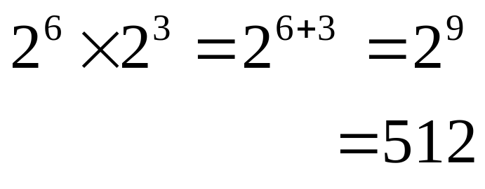
#2: Multiplying Powers: If you are multiplying Powers with the same base, KEEP the BASE & ADD the EXPONENTS!
So, I get it! When you multiply Powers, you add the exponents!

Slide 7
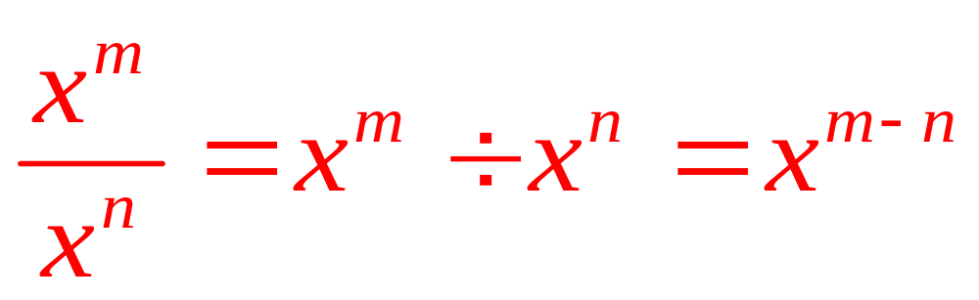
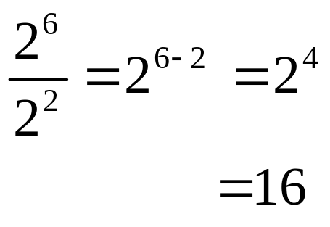
#3: Dividing Powers: When dividing Powers with the same base, KEEP the BASE & SUBTRACT the EXPONENTS!
So, I get it!
When you divide Powers, you subtract the exponents!

Slide 8
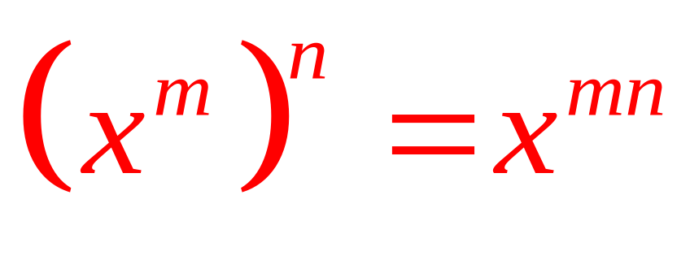
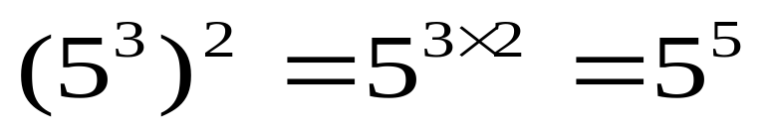
#4: Power of a Power: If you are raising a Power to an exponent, you multiply the exponents!
So, when I take a Power to a power, I multiply the exponents

Slide 9
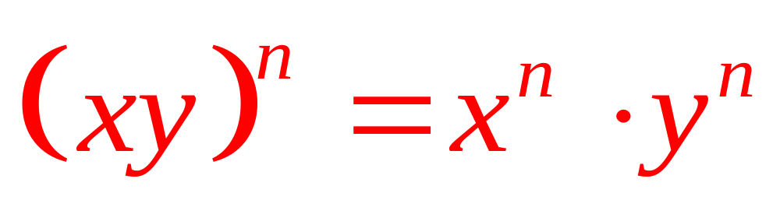
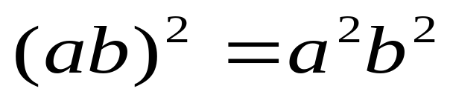
#5: Product Law of Exponents: If the product of the bases is powered by the same exponent, then the result is a multiplication of individual factors of the product, each powered by the given exponent.
So, when I take a Power of a Product, I apply the exponent to all factors of the product.

Slide 10
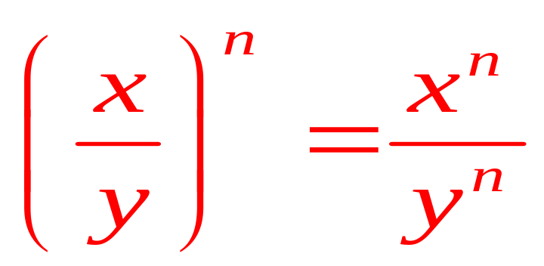
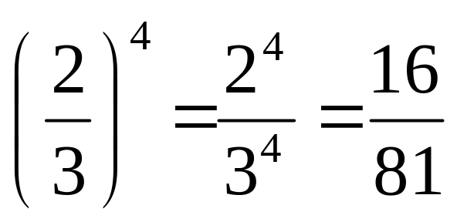
#6: Quotient Law of Exponents: If the quotient of the
bases is powered by the same exponent, then the result is both
numerator and denominator , each powered by the given exponent.
So, when I take a Power of a Quotient, I apply the exponent to all parts of the quotient.

Slide 11
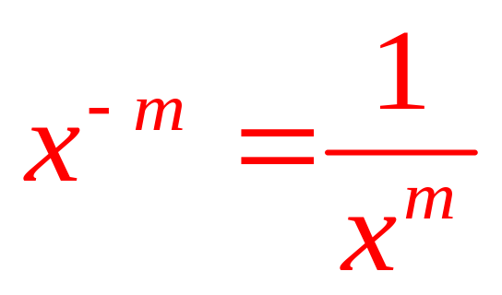
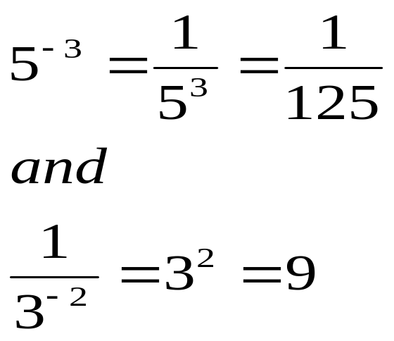
#7: Negative Law of Exponents: If the base is powered
by the negative exponent, then the base becomes reciprocal with the
positive exponent.
So, when I have a Negative Exponent, I switch the base to its reciprocal with a Positive Exponent.
Ha Ha!
If the base with the negative exponent is in the denominator, it moves to the numerator to lose its negative sign!

Slide 12
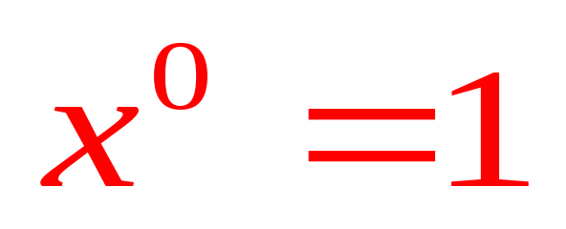
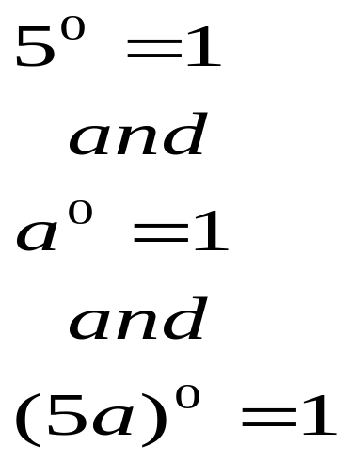
#8: Zero Law of Exponents: Any base powered by zero exponent equals one.
So zero factors of a base equals 1. That makes sense! Every power has a coefficient of 1.

Slide 13
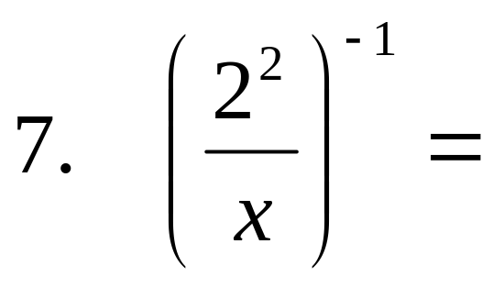
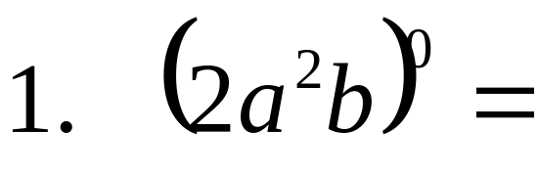
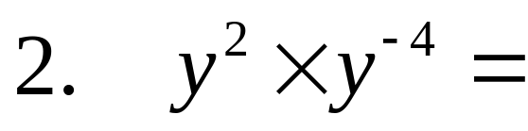
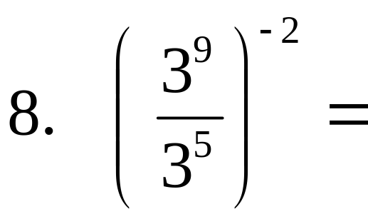
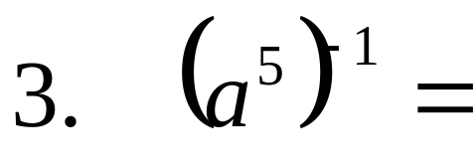
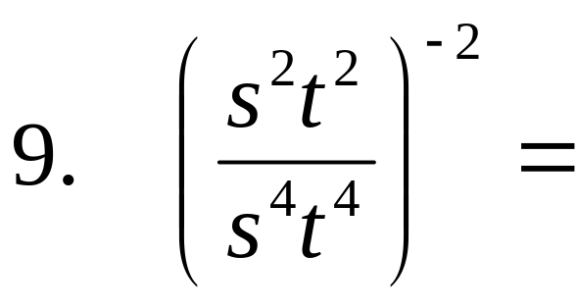
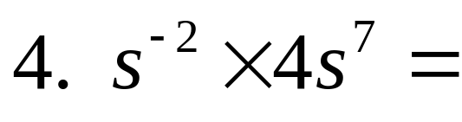
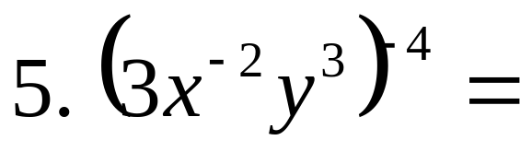
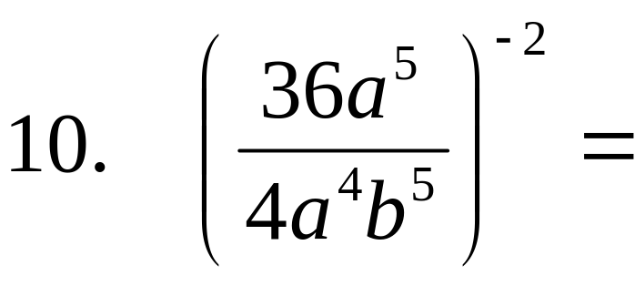
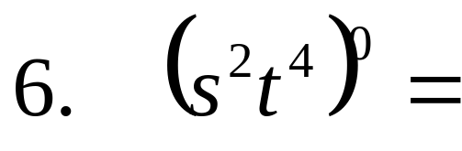
Try these:

Slide 14
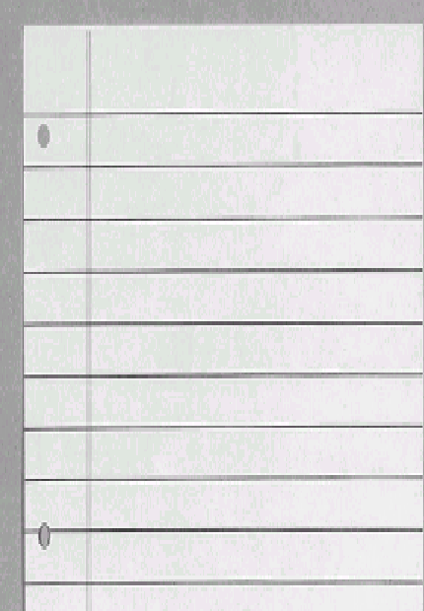
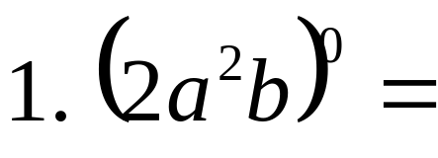

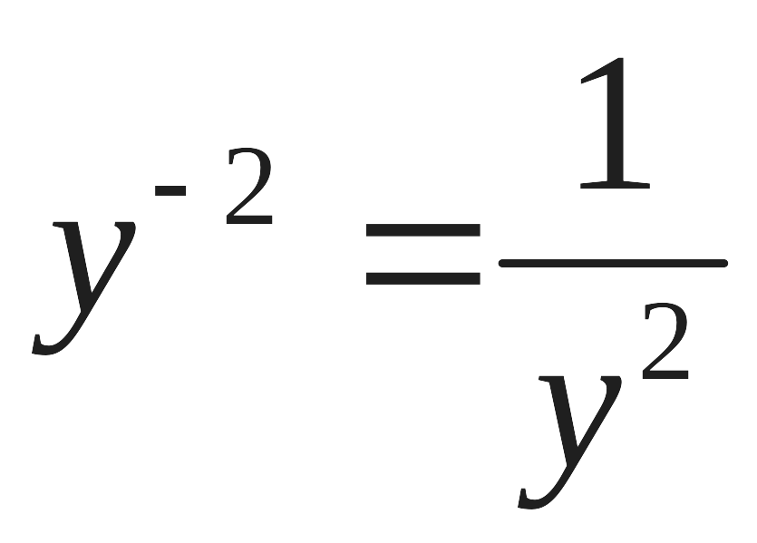
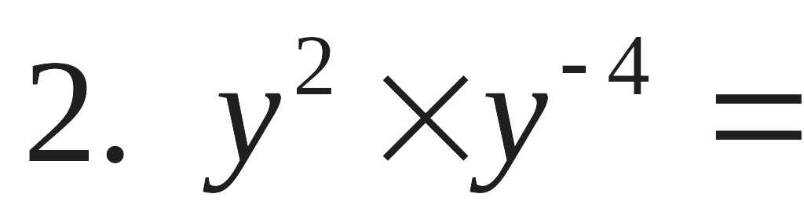
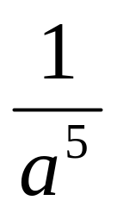
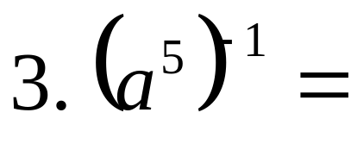
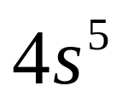
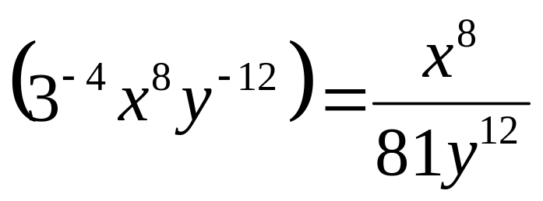
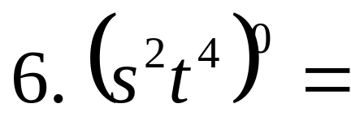

SOLUTIONS

Slide 15
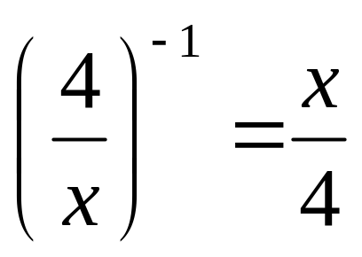
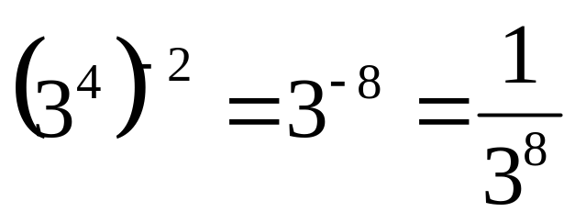
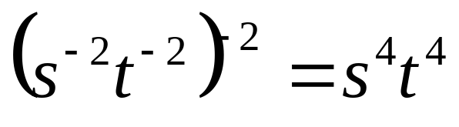
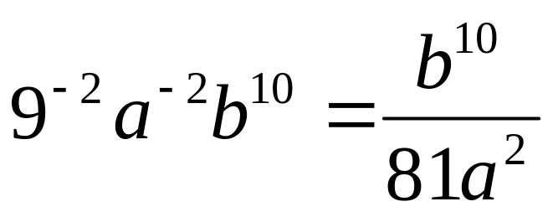
SOLUTIONS

Slide 16
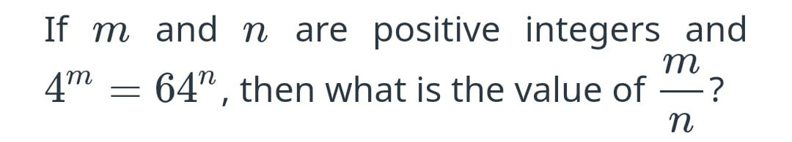
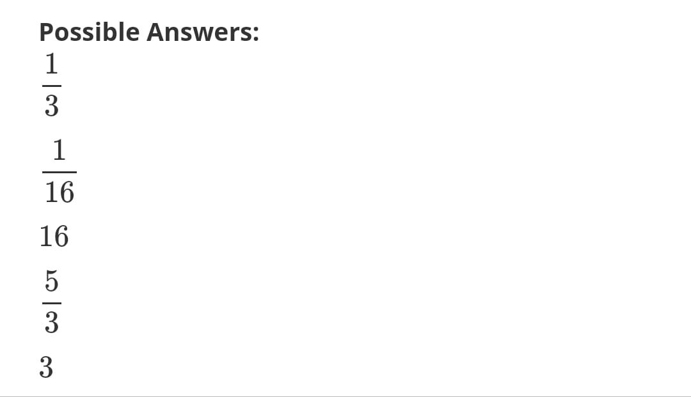
Ratio of Exponents

Slide 17
Explanation
Alternatively written, this is 4(4)(4) = 64 or 4³ = 64^{1.}
Thus, m = 3 and n = 1.
m/n = 3/1 = 3.

